Slide 1
Woodlands CS Club
Group B - Meeting 4
11/02/2020

Slide 2
Before we start
If you have any problems or questions, please feel free to ask them in chat.
In this meeting, we will assume that you have already attended our previous meetings
There is no prior knowledge of experience required to follow along with us!
All coded examples will be done in Python 3.
If you have any suggestions for the meetings or next week's topic, please let us know :)

Slide 3
This week's meeting contains...
Review (from two weeks ago)
Functions
Loops
Lists
Exploring problems involving loops and functions
N Triangles (from last week)
"Magical Functions" (GlobeX Cup J4)
Kahoot!
"Kahoot! of evil problem solving with loops and functions"
Notes:
https://create.kahoot.it/share/kahoot-of-evil-problem-solving-with-loops-and-functions/2462723c-f97f-40c2-bdd1-ba7408460c8c

Slide 4
Review: Functions
Recall a few things:
Functions are components of a program that perform a certain task ("function")
They are given a short name to represent multiple lines of code.
Benefits of functions:
Makes code more reusable
Makes code more readable and organized
Allows for a technique called "recursion"
Python includes "built-in" functions that could be used by the programmer
The keyword for writing functions in Python is "def"

Slide 5
Review: Loops
In python, there exists two types of loops: "for" loop and "while" loop. You may stop a loop by running the "break" (or "return" in some cases) and skip a turn in the loop by running "continue".
For Loop: Iterates over an "iterable object" → list, string (iterate over each letter) and stops when it is done iterating through the inputted item.
While Loop: Code repeats until the given condition is met.
Note: loops may run once or even zero times if the condition is met

Slide 6
Review: Lists
A list is a group of variables that can be accessed by its index.
new_list = ['apples','oranges','pears','grapes']
Lists are indexed starting from zero.
print(new_list[0])
Remove an item.
new_list.pop(2) # removes the item at index 2
new_list.pop() # if there is no argument, then it defaults to the last item

Slide 7
New: Dictionaries
Dictionaries in Python are unordered collections of pairs. Each pair has a key and a value. To create dictionaries in Python, use curly braces:
new_dict = {'apple' : 1, 'orange' : 2}
To access or add items, use the key.
print(new_dict['apple'])
To set the value of a key.
new_dict['apple'] = 5
Learning Tip: imagine the key of a dictionary as the index of a list

Slide 8
New: File Input/Output
To open a file in Python, use the built-in function "open", which returns a file object:
file = open("input.txt") # open file in current directory #open file in specific path file_somewhere_else = open("C:/Python39/input.txt")
If you want to edit the file, it must be specified upon opening. The modes are: r = opens file for reading (default) w = opens file for writing x = opens file for exclusive creation a = opens file for appending t = opens file in text mode b = opens file in binary mode + = opens file for reading and writing

Slide 9
New: File Input/Output
f = open("test.txt", mode='+', encoding='utf-8') #file operations f.close()
To write to a file:
f.write("This is a great file!\n") f.write("It has two lines now!\n")
This will create a new file if it didn't already exist.

Slide 10
New: File Input/Output
To read from a file:
f.read(7) #first 7 data f.read() #reads rest of file f.tell() #gets current file position f.seek(15) #changes file position
Alternatively, we can use readline().
f.readline()

Slide 11
New: File Input/Output
import math def pythagorean(a, b): return math.sqrt(a**2 + b**2) sides = open("sides.txt", mode='r', encoding='utf-8') answers = open("answers.txt", mode='w', encoding='utf-8') for line in sides: line_input = list(map(int,line.split())) answers.write(str(pythagorean(line_input[0],line_input[1]))) answers.write('\n') sides.close() answers.close()

Slide 12
Last (last) week's problem: N Triangles
Suppose you were given the length (AB) and width (BC) of triangle ABC which is right angled at B. You are told to form N new similar right-angled triangles that are connected by an overlapping edge at the hypotenuse of another triangle (refer to the following diagram). Find the final length of the hypotenuse of the largest triangle.
Answer

Slide 13
Solution: N Triangles
Suppose you were given the length (AB) and width (BC) of triangle ABC which is right angled at B. You are told to form N new similar right-angled triangles that are connected by an overlapping edge at the hypotenuse of another triangle (refer to the following diagram). Find the final length of the hypotenuse of the largest triangle.

Slide 14
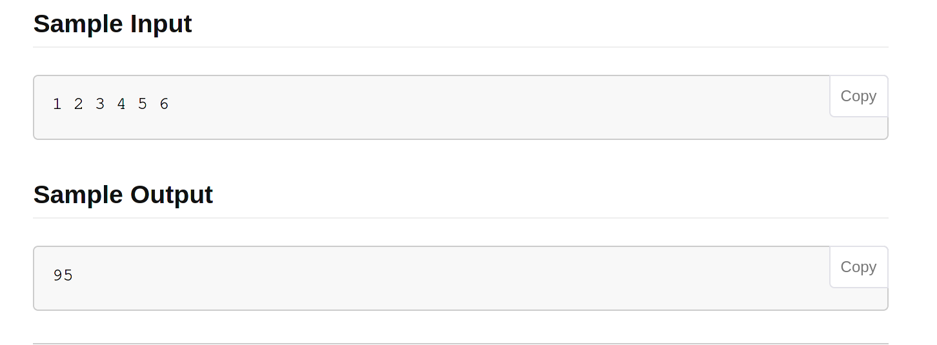
Next week's Problem: Functions
Link: https://dmoj.ca/problem/globexcup18j4
We will be covering the solution next week!

Slide 15
Some links...
https://www.learnpython.org/en/Loops
https://www.learnpython.org/en/Lists
https://www.learnpython.org/en/Dictionaries

Slide 16
KAHOOT!
https://create.kahoot.it/share/kahoot-of-evil-problem-solving-with-loops-and-functions/2462723c-f97f-40c2-bdd1-ba7408460c8c

